Slide 1


Mahavir Education Trust's
SHAH & ANCHOR KUTCHHI ENGINEERING COLLEGE
Chembur, Mumbai - 400088
UG Program in Computer Engineering
Hyperspectral Image Classification using Few Shot learning based on Prototypical Network
Guided by
1) Dr. Manimala Mahato
(Associate Professor at SAKEC)
2) Dr. Biplab Banerjee
(Associate Professor at IIT Bombay)
01

Slide 2
Group Members
Name | Class | Roll No.
Adit Chheda | BE9 | 15
Mayank Kantharia | BE9 | 21
Aditya Shah | BE9 | 38
Shivam Jadhav | BE9 | 17

Slide 3
01
Hyperspectral images (HSI)
Abstract
02
Few-shot Learning (FSL)
03
Stable Prototypical Network (SPN)

Slide 4
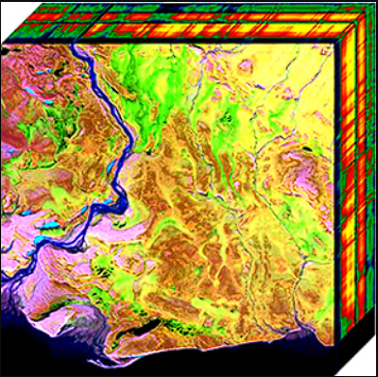
Introduction
Hyperspectral Imaging (HSI) Dataset
SPN: Few Shot Learning
Attention Layer
Temperature Scaling

Slide 5

Literature Review
1.Title of Paper: - SPN: Stable Prototypical Network for Few-Shot Learning-Based Hyperspectral Image Classification
Authors: - Debabrata Pal, Valay Bundele, Biplab Banerjee,Yogananda Jeppu
2. Title of Paper: - GAF-Net: Improving the Performance of Remote Sensing Image Fusion using Novel Global Self and Cross Attention Learning
Authors: - Ankit Jha, Shirsha Bose, Biplab Banerjee

Slide 6
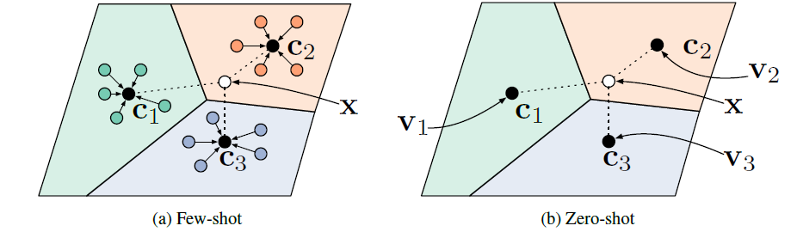

3. Title of Paper : - Prototypical Networks for Few-shot Learning
Authors : - Jake Snell, Kevin Swersky & Richard Zemel

Slide 7
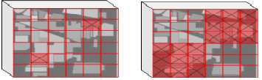
4. Title of Paper : -Controlled Dropout: a Different Approach
to Using Dropout on Deep Neural Network
Authors : - ByungSoo Ko, Han-Gyu Kim, Kyo-Joong
Oh & Ho-Jin Choi

Slide 8

Problem Definition
Hyperspectral Image Classification faces the challenge of small datasets, which can result in overfitting and poor generalization to new data. To address this issue, we aim to apply and enhance a state-of-the-art Few-Shot Learning method, Stable Prototypical Network (SPN), with Temperature Scaling and Attention Layer to improve the accuracy of Hyperspectral Image Classification with minimal training samples.

Slide 9

To extract useful information from few training samples.
01
Objectives
Reducing the effect of 'curse of dimensionality' from Hyperspectral Images.
02
Reduce the overfitting problem of the Few Shot Learning (FSL) systems.
03
Improve SPN using Temperature Scaling and Attention layer.
04

Slide 10

Scope
Research and implementation of Few-Shot Learning techniques, specifically the prototypical network approach, for Hyperspectral Image Classification.
Collection and preparation of a small dataset of Hyperspectral Images for training and testing the model.
Development and optimization of a prototypical network model for Few-Shot Learning in Hyperspectral Image Classification.
Evaluation of the model’s performance and accuracy in classifying Hyperspectral Images with minimal training samples.

Slide 11






Requirements
Python
Visual Studio Code Editor
Pytorch
Jupyter Notebook
TensorFlow
Keras

Slide 12
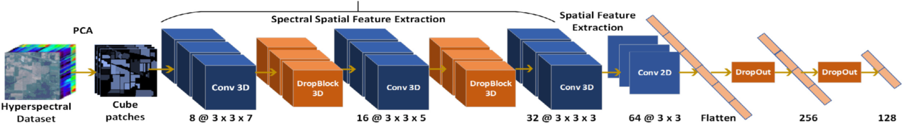
Existing SPN Architecture

Slide 13
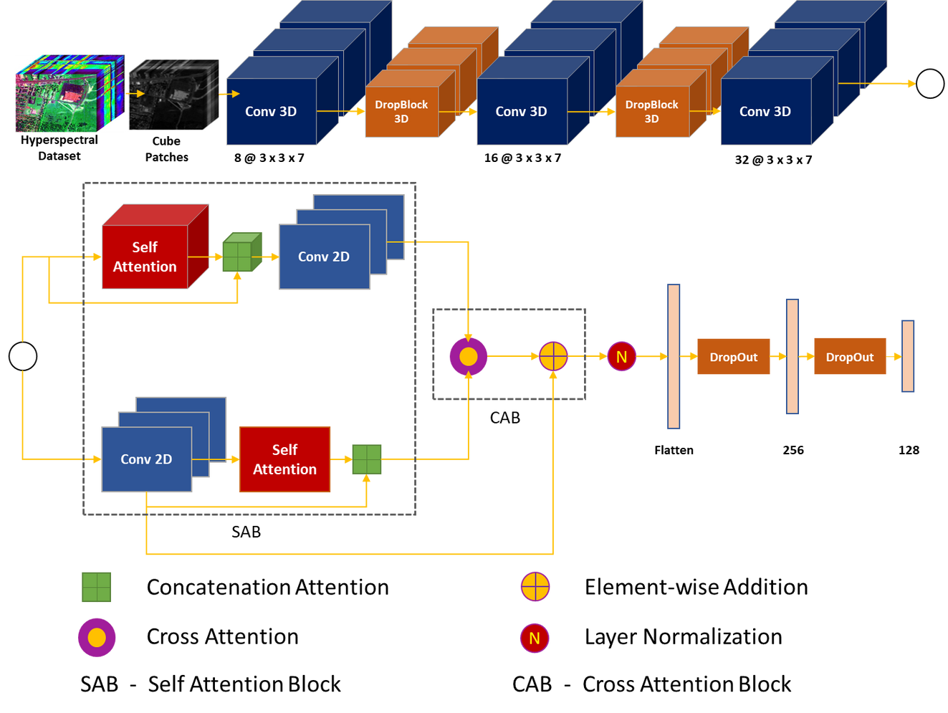
Proposed Methodology

Slide 14




Formulas
Softmax Activation function
Temperature Scaling using Softmax Activation Function

Slide 15
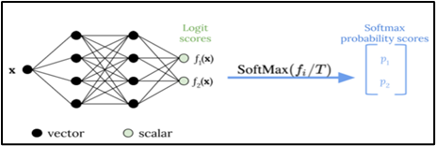
Formulas
Softmax Activation function

Slide 16
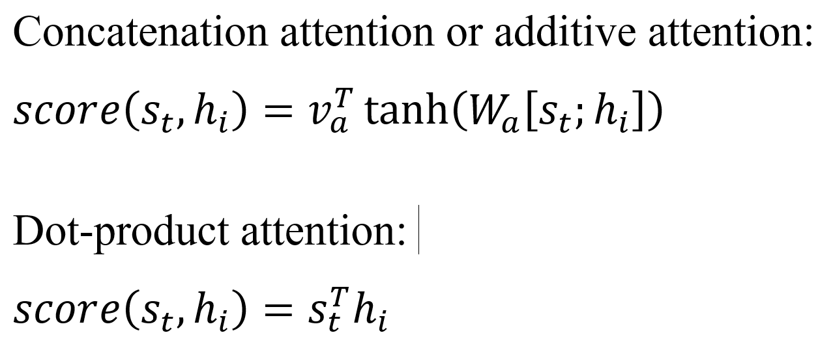
Formulas

Slide 17
Result Analysis
Uncertainty estimation (UE) Methods
Aim to improve the interpretability of machine learning models by assigning an estimated uncertainty value to each of their prediction outputs.
UE techniques such as the : -
Monte Carlo dropout (MCDropout) (Used with SPN)
Temperature Scaling (Used with SPN)

Slide 18
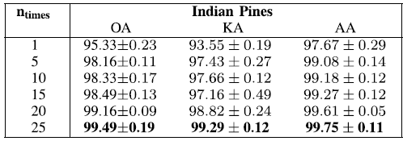
Results of SPN

Slide 19
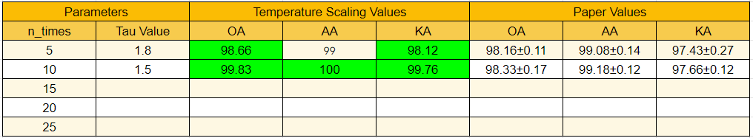
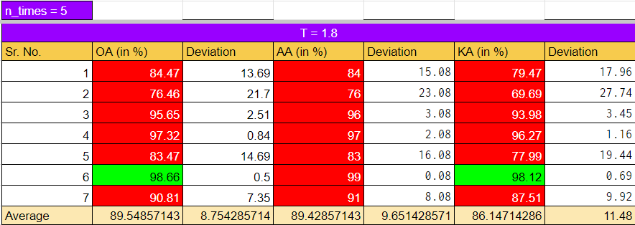
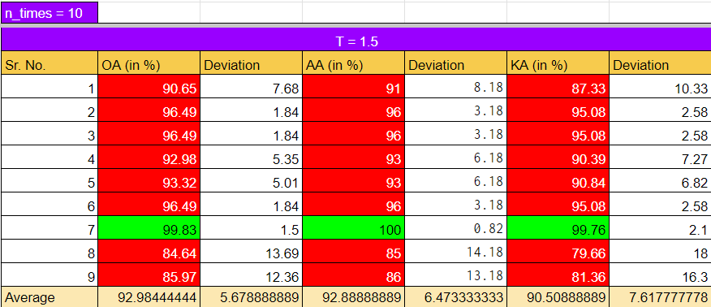
Results of SPN + Temperature Scaling

Slide 20
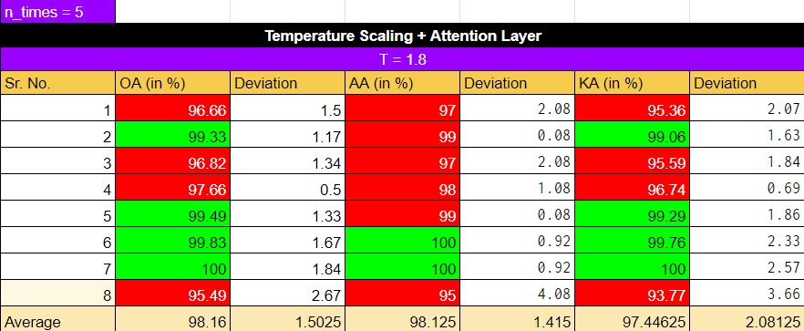
Results of SPN + Temperature Scaling + Attention Layer

Slide 21
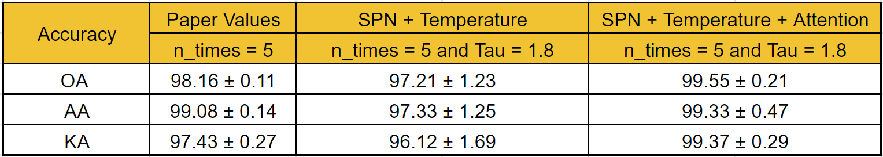
Comparison of SPN, Temperature Scaling and Attention Layer

Slide 22
01
Dataset: HSI (Indian Pines)
02
Architecture: Modified SPN
Summary
Performance Measurement: Temperature Scaling
03
04
Attention Mechanism

